Slide 1

Group 11
Project Proposal - Trip@Us
A0213523U | Mehta Vidish Pranav
A0213496B | Ankeit Taksh
A0198539H | Wang Kuan-Kai
A0213514U | Anandan Natarajan
Notes:
Hello everyone, we’re group 11.
In our team, we get Anand, Taksh, Sonic, Vidish.
It will be our honor to present you guys a newly released product Trip @us
Here we go to the next slide

Slide 2

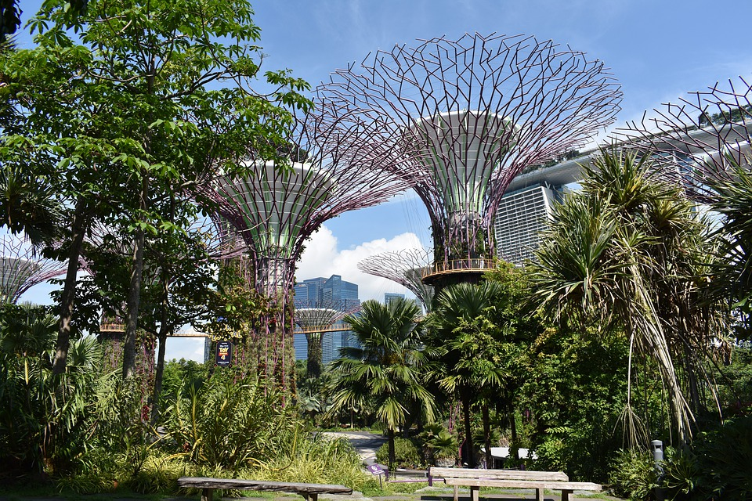
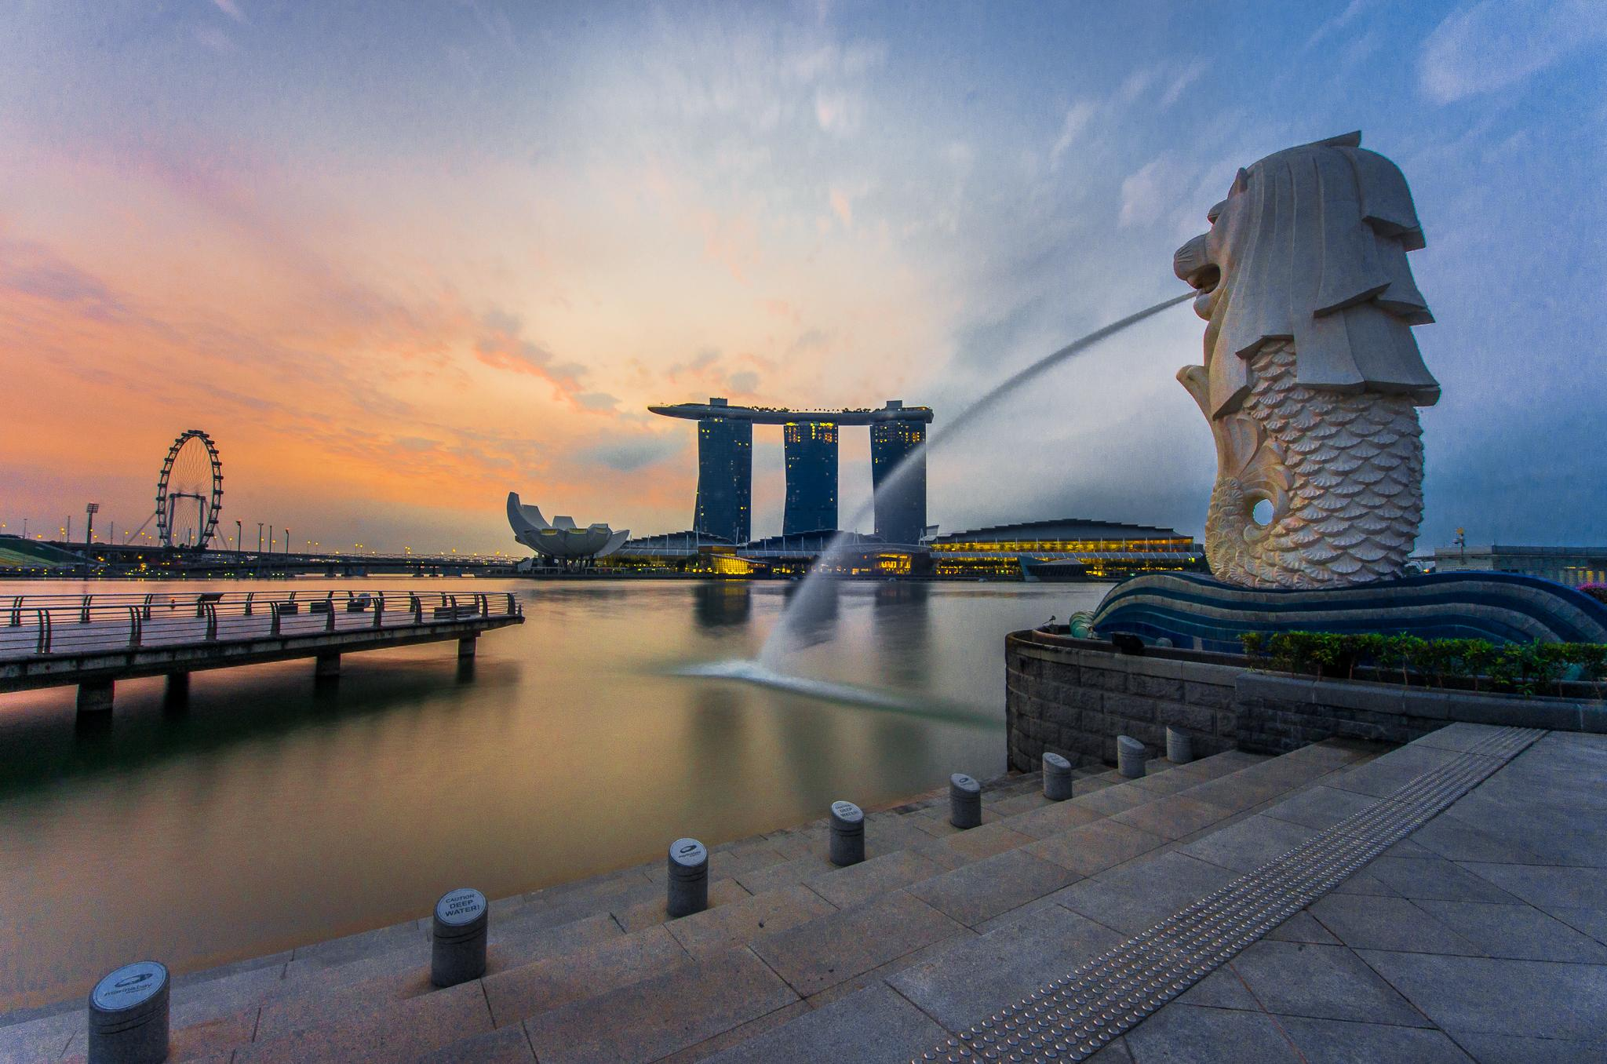
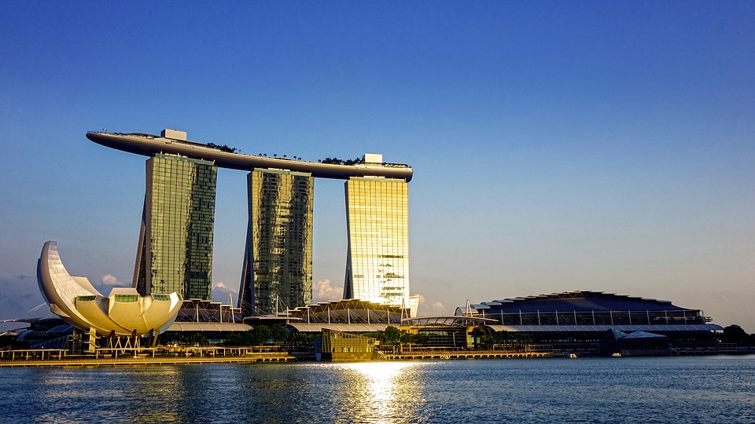
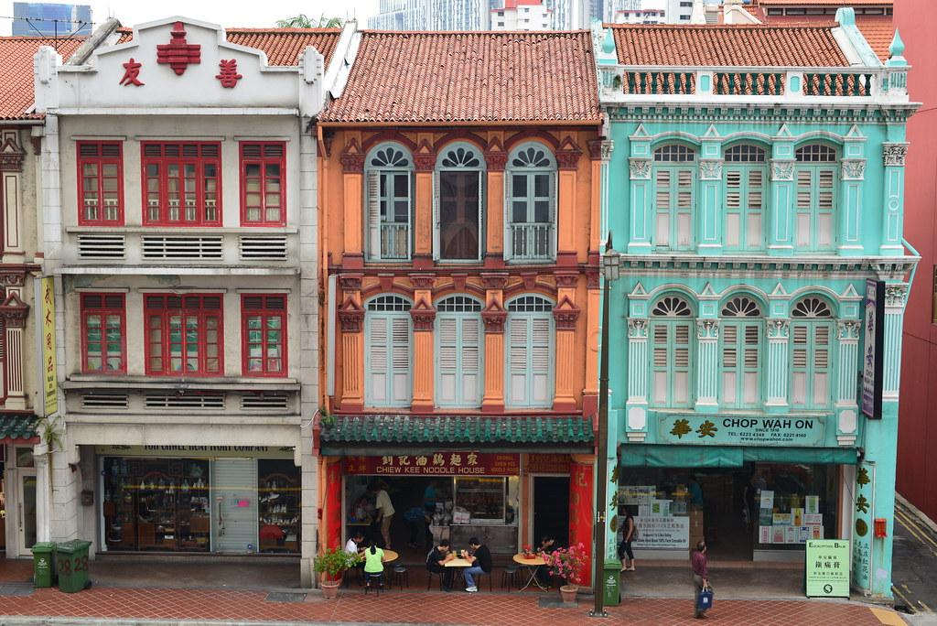
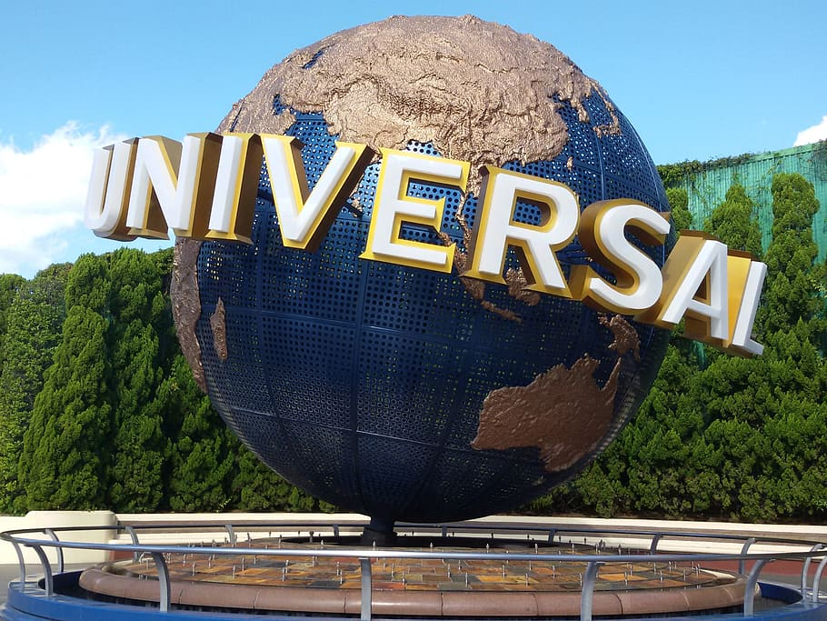
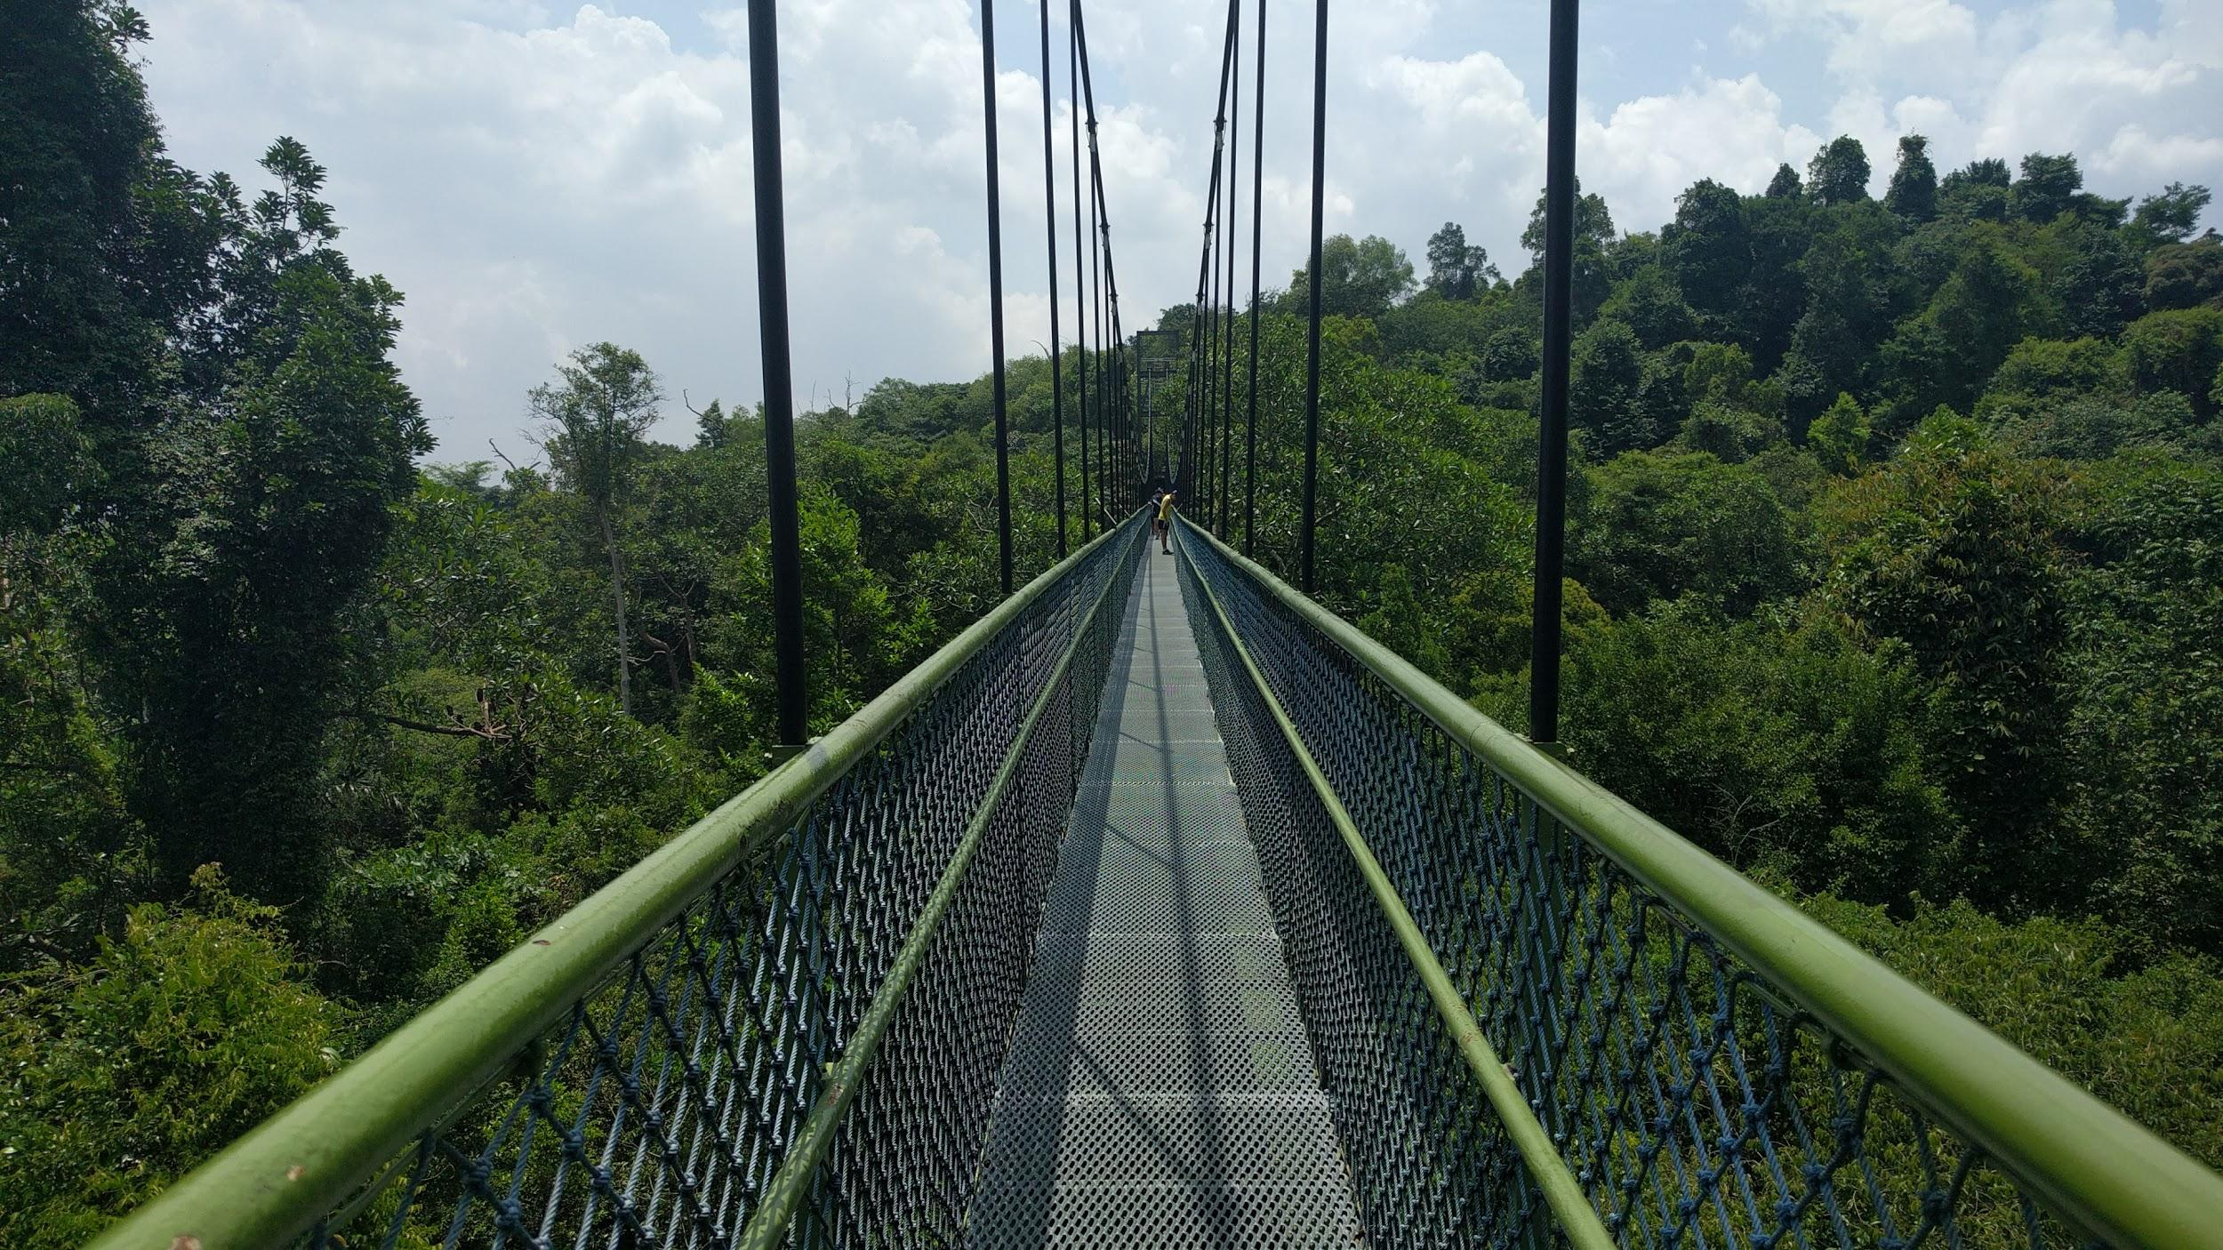
Imagine you are a tourist in Singapore
Notes:
Now, imagine yourself as a tourist who don’t know anything about Singapore.
You just do your research online and found there are so many places to visit in Singapore.
However, you don’t know what is the perfect location of your hotel and you also don’t know how to plan your itinerary
In next slides, we did some market research and would like to present you some market intel.

Slide 3

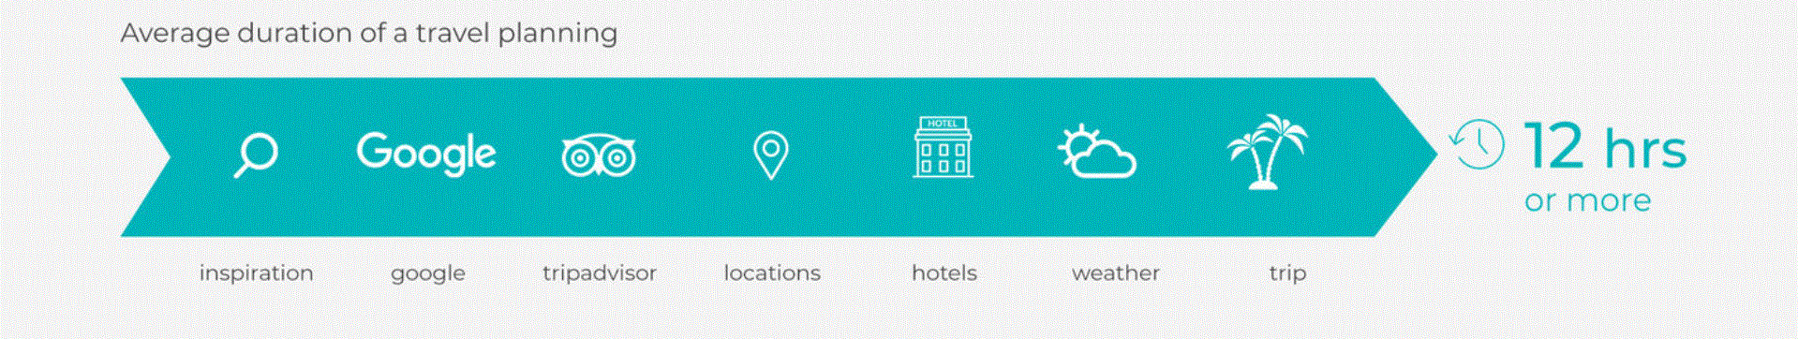
Trip@Us - Pain Point
How much time do people spend on planning?
Notes:
Let’s talk about the pain point. Do you know that how many time do people spend on planning?
In general, it takes 12 hours to plan your hotel and itinerary
Follow by next slides

Slide 4



Trip@Us - Pain Point
And people hate planning
Notes:
We can totally understand why people hate planning a trip.
Let’s go to the next sides

Slide 5
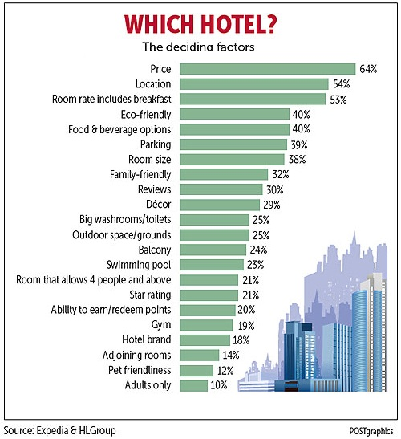
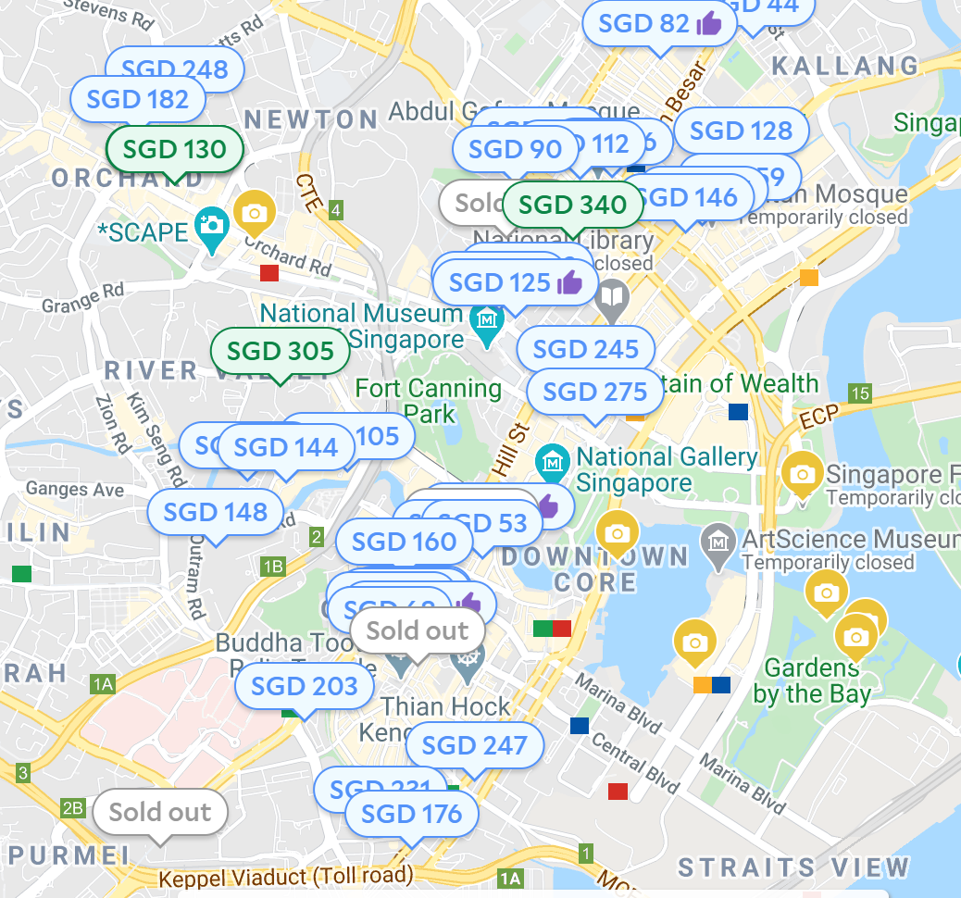
Trip@Us - Pain Point
Planning - Hotel
Which hotel to choose?
Notes:
Planning a trip, first thing you need to do is decide a hotel!
Right hand side, you can see that Price and Location are the most important criteria.
However, when you go to Agoda to find a hotel; here comes a long list of hotel and you will be so lost; you don’t know which hotel to choose.
Follow by the next side

Slide 6
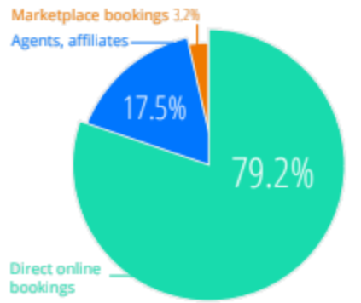
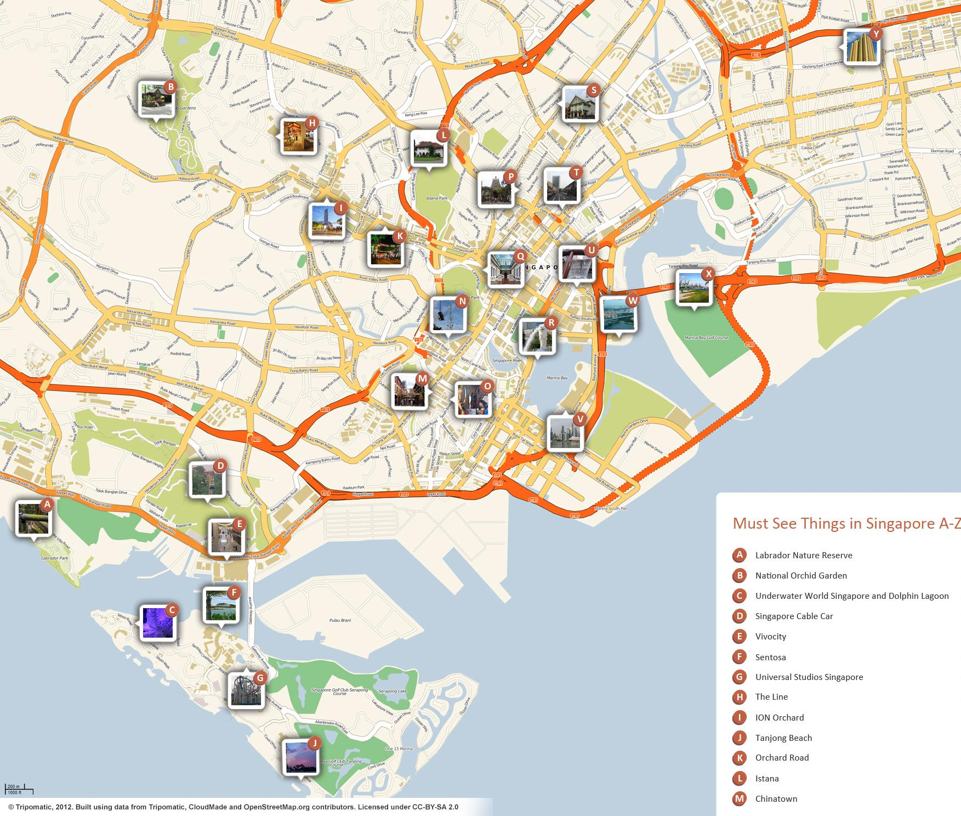
Trip@Us - Pain Point
Planning - Itinerary
How to plan itinerary?
Notes:
Right after, you decide which hotel to stay. You will still need to decide your itinerary.
We can see from the pie chart on the left, nowadays people tend to plan the itinerary by themselves.
But there are so many places to visit in Singapore, how to plan the perfect itinerary?
Hotel and Itinerary are the most critical pain point in the market.
Let’s move on to the next slide

Slide 7

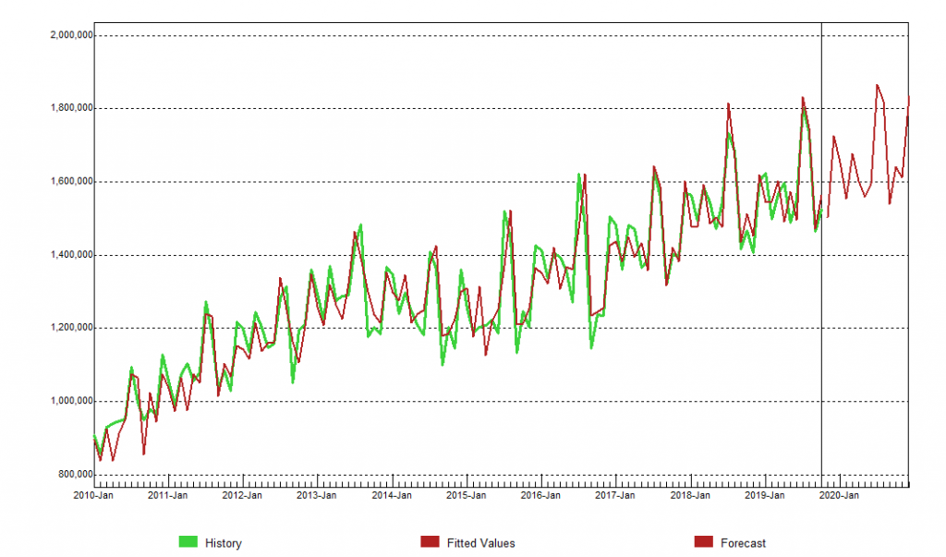
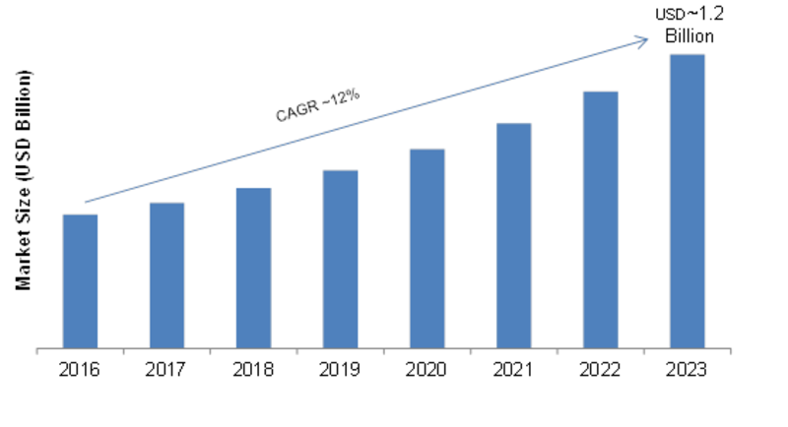
Trip@Us - Market Research
Market Trend Analysis
Tourist in Singapore has shown a steady increase over the years - post covid-19 we expect the tourism industry to boom further
Tourism industry in Singapore has seen a projectile growth in the past years projected to further increase
Sources: Data.Gov.Sg API Data
Notes:
On the left, it’s the tourist amount
On the right, it’s the value of tourism industry
We can see from the slide, it’s increasing year by year
Let’s go to the next slide

Slide 8

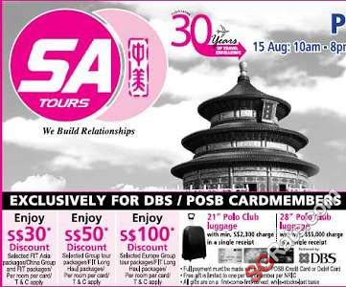


Trip@Us - Market Research
Competitor Analysis
Improve:
Proactive recommendation
No distance to the attractions
No location optimization of hotel
No flexibility in itinerary
Notes:
Let’s evaluate current product in the market
Even though you can find a hotel in Agoda and Booking.com
They just provide you a long list of hotel, no
And when we talk about travel agency, there is no flexibility in itinerary
The most important slides in coming

Slide 9
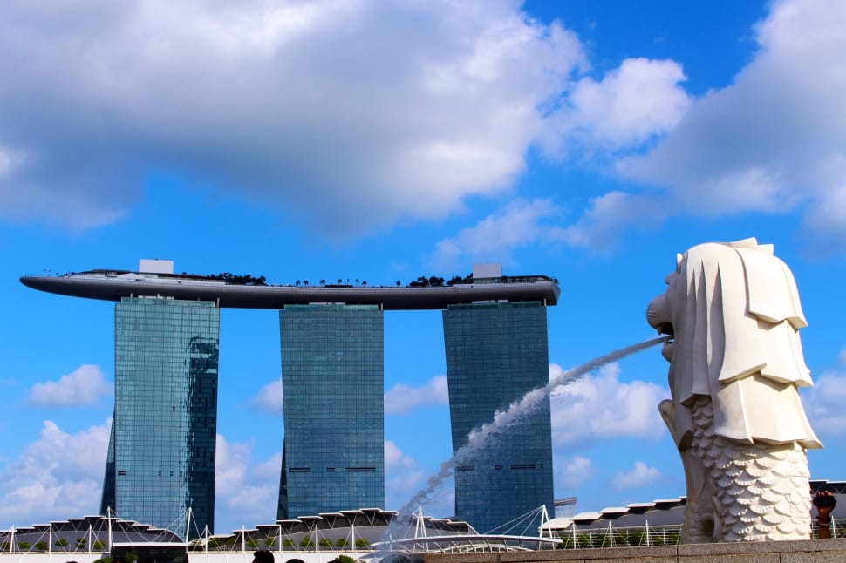
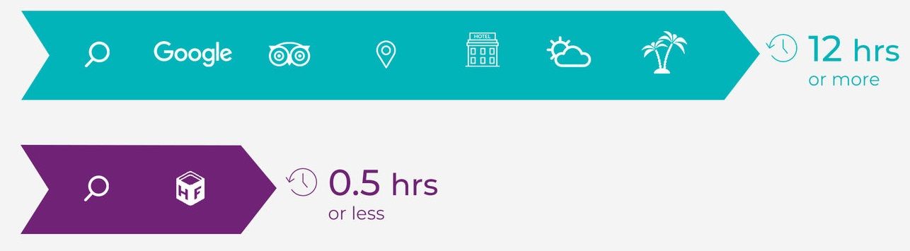
Introducing Trip@Us
Intelligent Reasoning & Recommender System
An one-stop optimum hotel and itinerary planner.
Your Dream Trip is just a few clicks away!
Notes:
Our product - Trip at us
Help you to reduce the planning time from 12 hours to only 30 minutes.
Just a few clicks you will have your dream hotel in perfect location also a perfect intinerary for you
Let me hang over to my teammates - Vidish

Slide 10
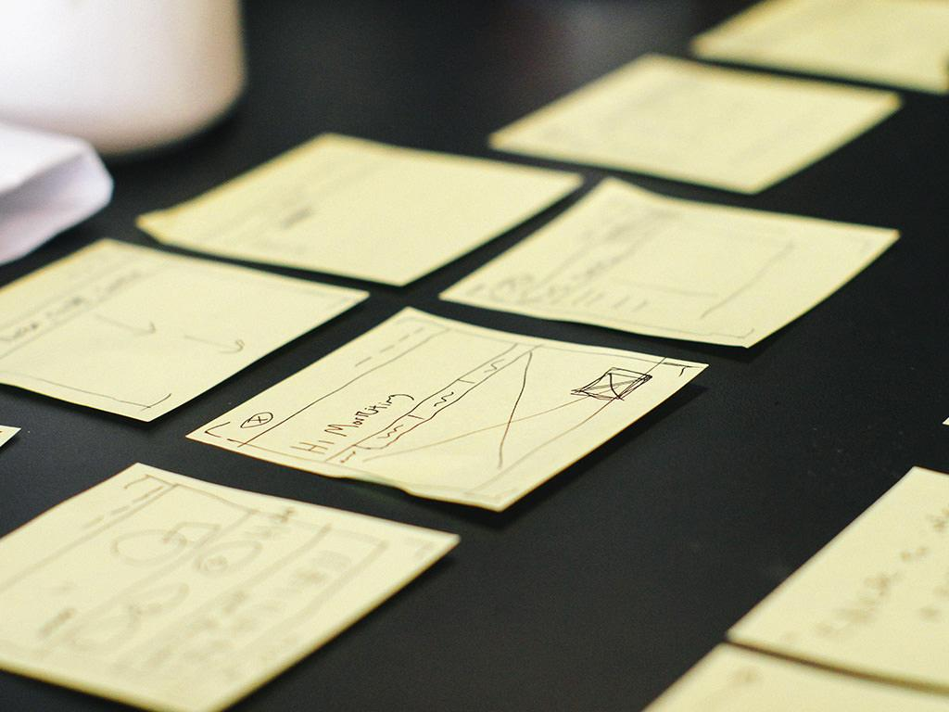
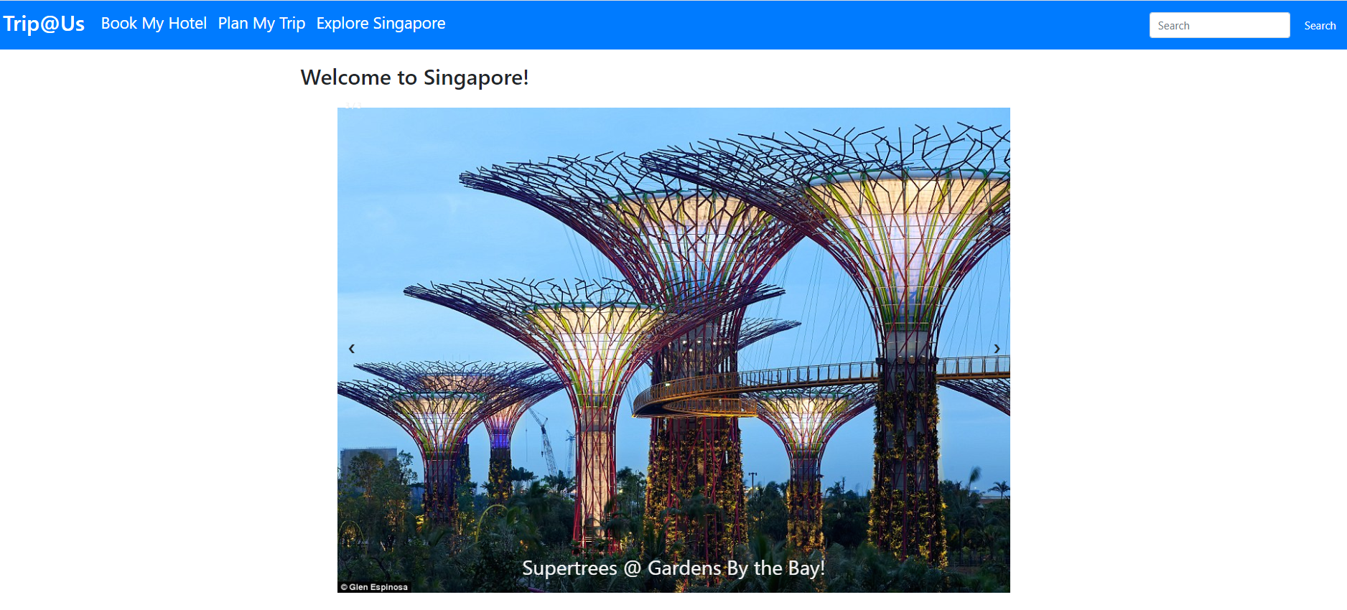
Trip@Us
Simple & easy UI that uses search & optimization algorithm to reduce travel time so tourists can enjoy more & travel less
“Book my hotel” uses heuristics to encompass and traverse the search space based on user prefered travel locations
“Plan my trip” uses a hybrid reasoning system that combines GA with Greedy BFS search to minimize your travel time
Notes:
Trip@Us has a simple and intuitive user interface that uses search & optimization techniques to help tourists plan their trip in Singapore. At our welcome page, tourists can spot two features of our planner - Book my hotel and plan my trip. Book my hotel is a smart hotel recommender system that uses heuristic to traverse search space whilst plan my trip curates a customised itinerary based on a hybrid reasoning system that combines Greedy BFS search with Genetic Algorithm. Let’s look at each of these features in more detail.

Slide 11

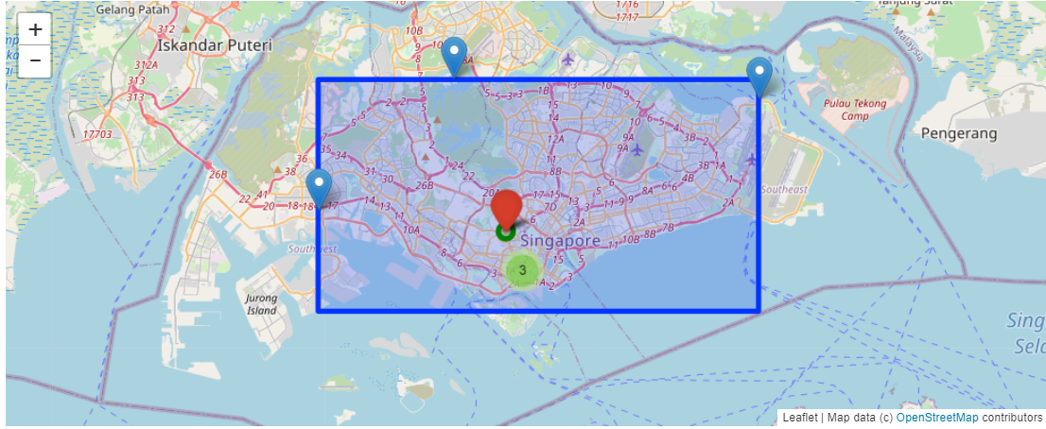
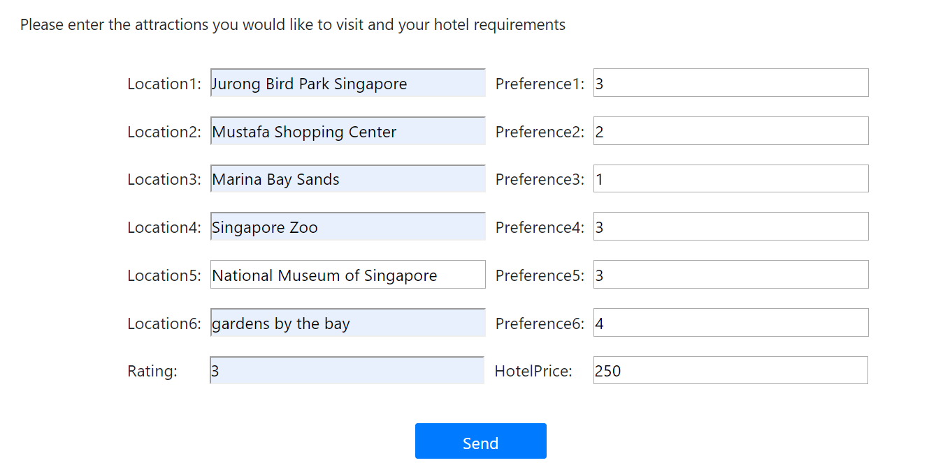
Trip@Us - Book My Hotel
Hotel recommendation system based on user travel preferences and travel distance.
Uses inference rule system to recommend hotel that meets your price, rating and travelling
Orchard Hotel
Notes:
The book my hotel feature takes user’s preference for travelling to certain sightseeing attractions, plots the coordinates on the map and then encompasses a rectangular search space around it. The search space is then gridded into smaller nodes and each node is evaluated based on distance and preference of these sightseeing locations. Once the optimum node is computed, it uses a rule based system to recommends nearby hotels that both meet price and rating requirements of our tourist. In the next slide, you can see this algorithm in action:

Slide 12
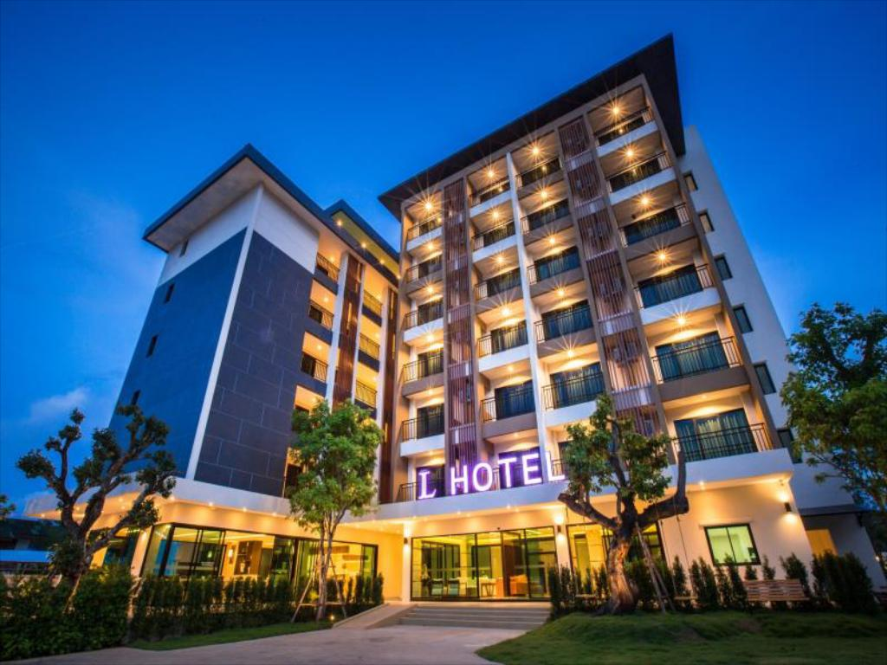
Trip@Us - Book My Hotel
Great, you found an awesome hotel that optimizes the location based on your preferences
Notes:
And walla, you have got an awesome hotel that optimises the travelling time to each of your sight seeing locations, significantly reduces your planning time meets all your requirements. But wait, we have only reached half-way, we still need to plan your trip and this brings us to the next feature

Slide 13

Trip@Us - Plan My Trip
Hybrid reasoning system that combines
Genetic Algorithm and Greedy BFS search to optimise travel itinerary
User inputs
Locations of travel
No. of locations to visit per day (hard constraint)
Greedy BFS Search Tree Combinations
Locations: 12
Locations/day: 4
Day 1: 12C4 → 495 places
Day 2: 8C4 → 70 places
Day 3: 4C4 → 1 place
Problem Definition
Start State: [0,0,...0]
0 → not visited
1 → visited
Goal State: [1,1...1]
Successor Function: roads
Notes:
Our plan my trip feature uses hybrid reasoning systems that combines Greedy BFS search with GA. Tourist’s are required to specify their places to sightsee and the no of locations they would like to visit per day with the latter being used as a hard constraint. Greedy BFS search tree is charted by the various combinations in which tourists can visit these places. So for example, if there are 12 locations and 4 locations/day is the hard constraint, then on day 1 there will be 495 combinations to choose from, day2 there will be 70 and on the last day we will be left with only 1. The start state is defined as a matrix of 0 with one row and columns representing no. of locations to visit. So, State 0 represents a location not visited and therefore at start state it is a matrix of 0’s and you have not visited any of the locations. End state is marked by a matrix of 1 with all places visited.

Slide 14

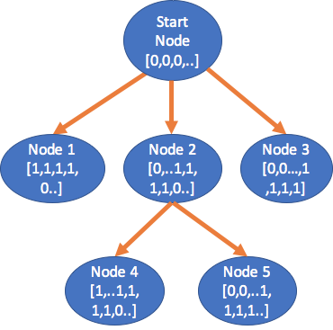
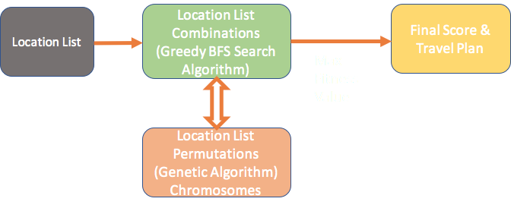
Trip@Us - Plan My Trip
Hybrid reasoning system that combines Genetic Algorithm and Greedy BFS search to optimise travel itinerary
Genetic Algorithm (Permutations)
Day 1 to Day 3: 4! (24 ways to travel)
Fitness function = 1/total distance
Notes:
While the various combinations act as branches of the tree, Genetic algorithm is used to permute through the combination and feedback the optimised fitness function for the specific combination. The heuristic value is then used by the greedy BFS search to traverse through the space and proceed with the maximum fitness value. Once the entire depth of the tree is covered, a unique curated itinerary for each day is created that aims to minimize the total travelling distance. As this task is computationally intensive, our application uses asynchronous task processing and emails the curated itinerary to the end user.

Slide 15
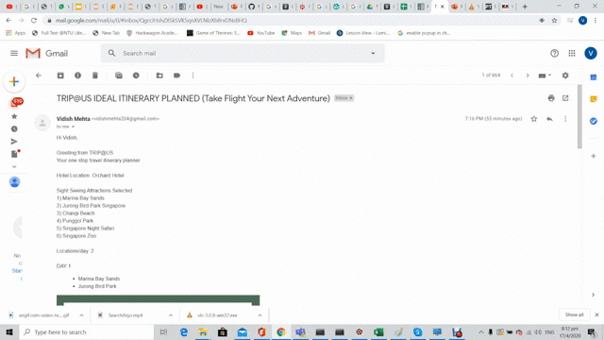
Trip@Us - Plan My Trip
Notes:
The itinerary comprises of a day by day segregation of the places to visit as well as the chronological order in which to visit them so that you can spend maximum time at sightseeing location.

Slide 16

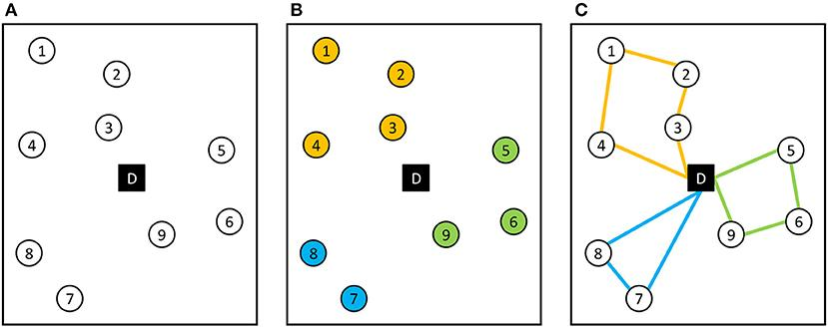
Trip@Us - Plan My Trip
Traversing all combinations through Greedy BFS Search and evaluating all permutations through GA, we have found the most optimum itinerary for you
Notes:
This is how we have used the combinations of the greedy best first search and the permutations from GA to find the optimum itinerary for you :)

Slide 17
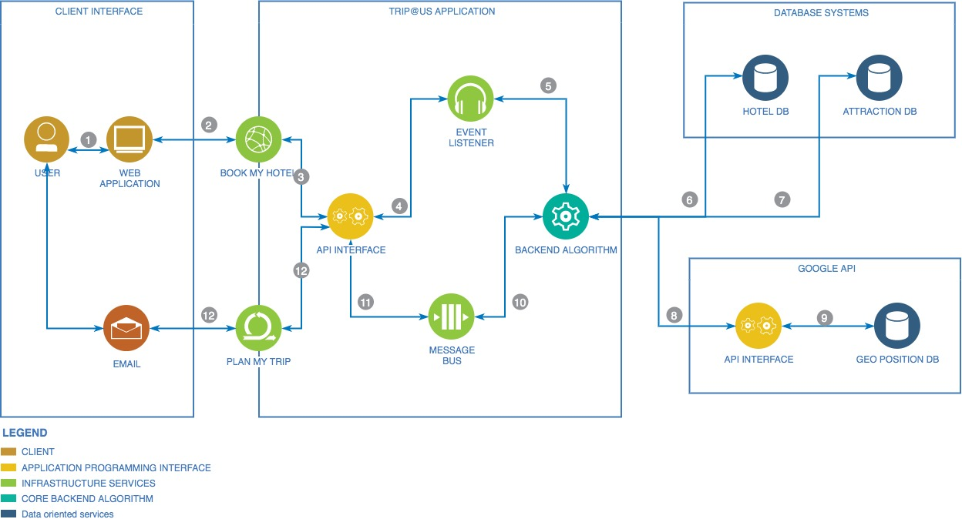
Data Flow & System Architecture
Data Flow Diagram
Notes:
Our application data flow diagram is divided into 4 part first of which is the client interface for our tourist’s to interact with the system. Our trip@us application interface consists of the API backend with an event listener and a message broker for triggering our core backend services. The backend services are connected to our curated database system for hotel and sightseeing attractions in Singapore as well as to the google API to obtain the geopositional coordinates.

Slide 18
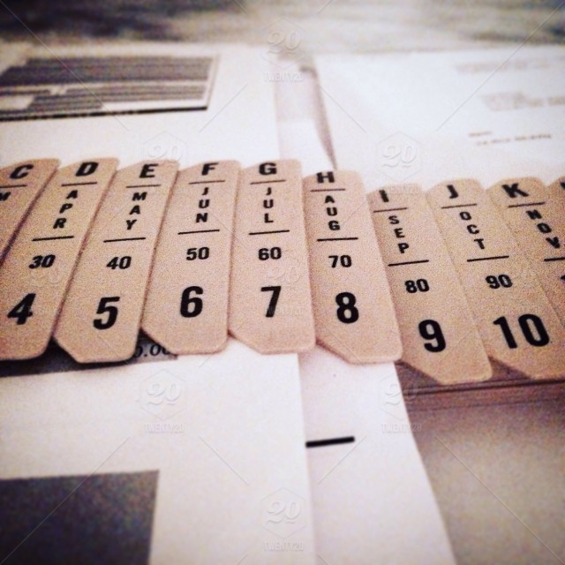
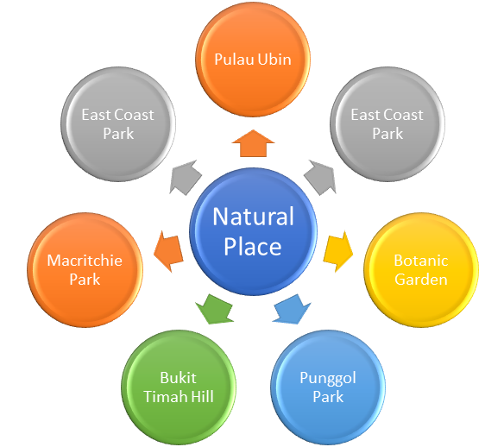
Future Work (near)
Combination of Rule Based System & manually generated ConceptNet (Semantic Ontology) to create a cognitive system for smart recommendation of similar tourist locations
IsA
IsA
IsA
IsA
IsA
IsA
IsA
IsA
IsA
IsA
IsA
IsA
IsA
Notes:
So far, we have helped our users with book their hotels and plan their itineraries allowing them to spend more time at the location. However, there is an opportunity for us to create a ConceptNet semantic ontology for similar sightseeing locations and use a rule based system to detect user preferences and provide smart recommendations to them. For example, if user prefers 50% or more natural places, then the semantic ontology could be used to recommend similar places.

Slide 19
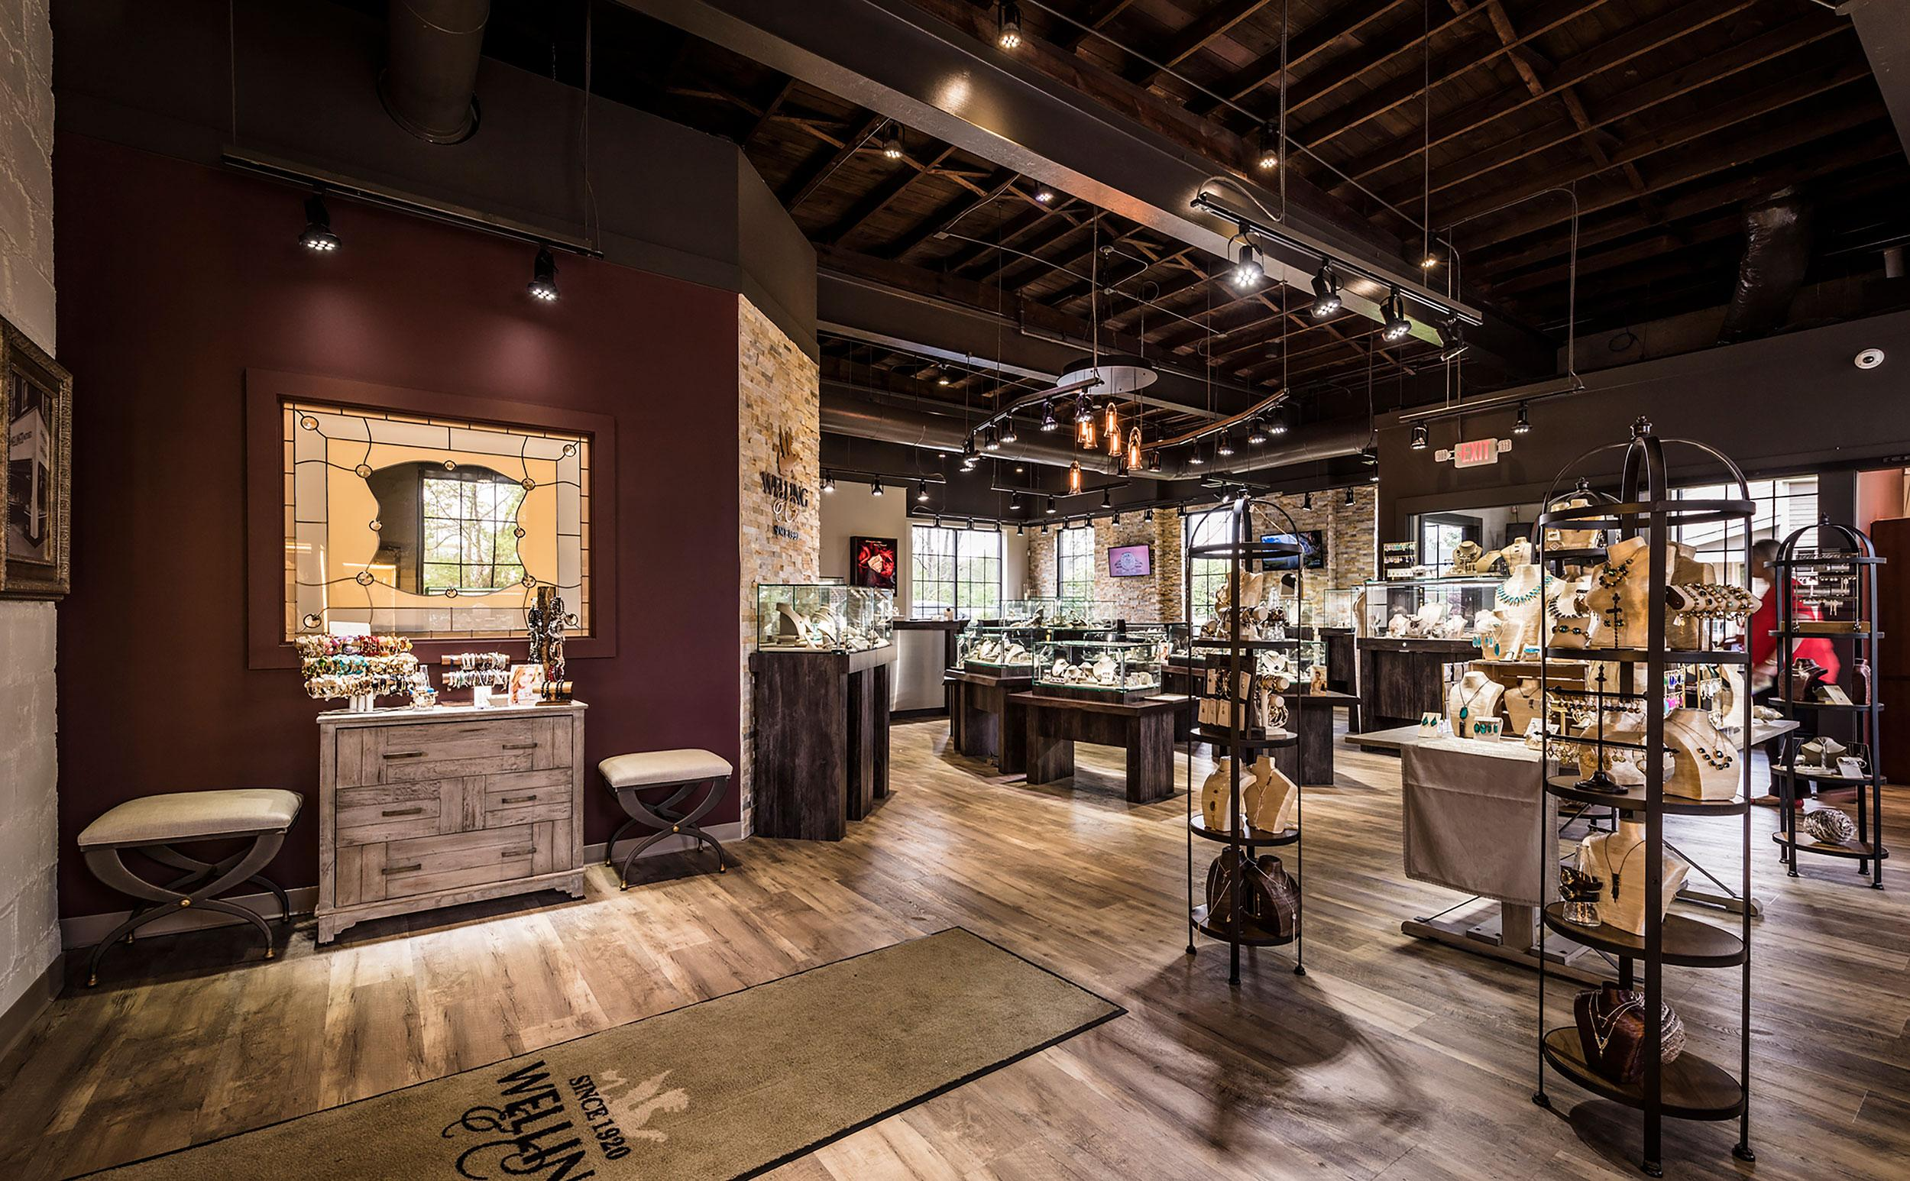

Version 2 Enhancements
Voice enabled command system to allow users to verbally communicate with system
Notes:
Finally in our version 2 enhancements, we would be developing an in-house machine learning based voice enabled command system that allows users to verbally communicate with our system. So to conclude,

Slide 20

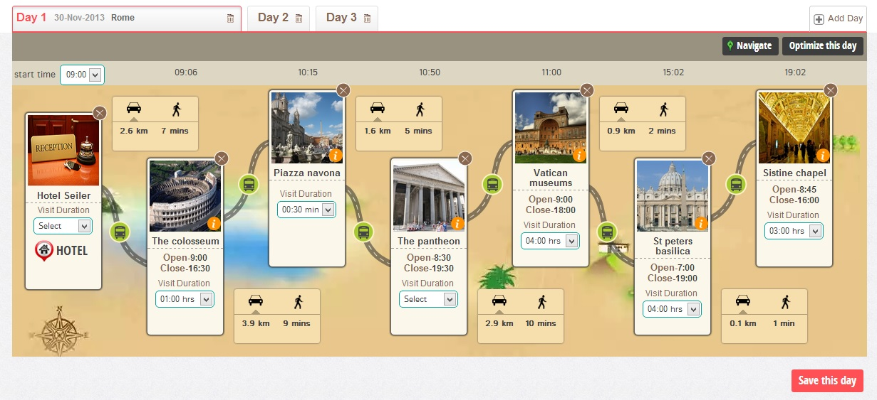
Conclusion
Trip@Us is your friendly travel buddy that provides recommendation yet gives you the flexibility to choose :)
[Pictures to be added here]
Notes:
Trip@Us is your friendly trip recommender system that follows you throughout the journey of planning from booking a hotel to planning a trip. The 12 hrs or more of painful planning is reduced to less than 30 mins of smart recommendation systems with further benefits derived from reduced travelling time. With this I would like to wish you

Slide 21
Happy Tripping

Slide 22

Binary Linear Programming
Popularity Score for each attraction amongst different groups of travelers
Optimisation Function
Max(Likeability Score) where
Likeability = SumProduct(Preference(tim) * Popularity (attraction))
Decision Variable
Binary (1,0) values of attractions
Constraints
Time(attraction)*Selected(attraction) <= Duration of trip
10 hours/day of travelling
Notes:
Finally in our version 2 enhancements, we would be developing an in-house machine learning based voice enabled command system that allows users to verbally communicate with our system. So to conclude,

Slide 23

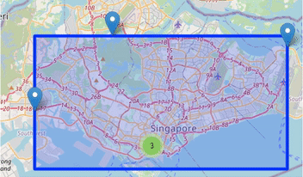
Book My Hotel
Brute force search algorithm using distance based heuristics
Each node is evaluated based on actual distance and user preference with nearby hotels as recommended to stay
D = 40km
D = 32km
Notes:
We are using a Brute force search algorithm that traverses the search space by computing the euclidean distance to each of the sightseeing locations and an assigned weight from user preferences. The node with the least overall node score in terms of distance is the optimised node and hotels nearby meeting both price and rating requirements are recommended.

Slide 24

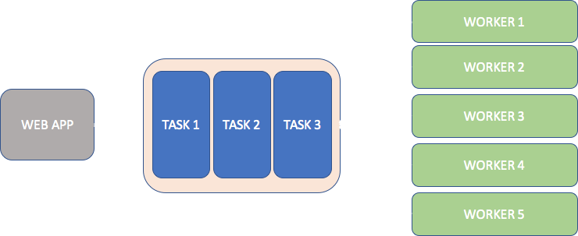
Data Flow & System Architecture
Asynchronous Task Processing - Plan My Trip
Celery Workers
Rabbitmq Message Broker
Notes:
Due to the computational intensity of Plan my trip feature, asynchronous task processing with redis message brokerage service and djangoq workers is used to execute requests in parallel thus making our application scalable. While the book my hotel feature provides instantaneous results directly displayed to our tourists.

Slide 25
Data Flow & System Architecture
Asynchronous Task Processing - Plan My Trip
Celery Workers
Rabbitmq Message Broker
Worker A
TASK A
TASK B
Worker B
CLIENT
Worker C
Worker D
Notes:
Due to the computational intensity of Plan my trip feature, asynchronous task processing with redis message brokerage service and djangoq workers is used to execute requests in parallel thus making our application scalable. While the book my hotel feature provides instantaneous results directly displayed to our tourists.

Slide 26
Trip@Us - Plan My Trip
Hybrid reasoning system that combines
Greedy BFS search and Genetic Algorithm to optimise travel itinerary
Start State
[0,0,0,...]
Problem Definition
Start State: [0,0,...0]
0 → not visited
1 → visited
Goal State: [1,1...1]
Successor Function: roads
Comb A
Comb B
Comb C
[1,0,1,...]
[0,0,1,1,1...]
[0,0,1,1,1...]
Comb D
Comb E
Comb F
[1,0,01,1...]
[0,0,1,1,1...]
[0,0,1,01...]
Notes:
Our plan my trip feature uses hybrid reasoning systems that combines Greedy BFS search with GA. Tourist’s are required to specify their places to sightsee and the no of locations they would like to visit per day with the latter being used as a hard constraint. Greedy BFS search tree is charted by the various combinations in which tourists can visit these places. So for example, if there are 12 locations and 4 locations/day is the hard constraint, then on day 1 there will be 495 combinations to choose from, day2 there will be 70 and on the last day we will be left with only 1. The start state is defined as a matrix of 0 with one row and columns representing no. of locations to visit. So, State 0 represents a location not visited and therefore at start state it is a matrix of 0’s and you have not visited any of the locations. End state is marked by a matrix of 1 with all places visited.

Slide 27
Trip@Us - Plan My Trip
Hybrid reasoning system that combines
Genetic Algorithm and Greedy BFS search to optimise travel itinerary
Start State
[0,0,0,...]
GA
Chromosome: Permutation of visiting places
Fitness Function: 1/Total Distance
DAY 1
Comb A
Comb B
Comb C
[1,0,1,...]
[0,0,1,1,1...]
[0,0,1,1,1...]
DAY 2
Comb D
Comb E
Comb F
[1,0,01,1...]
[0,0,1,1,1...]
[0,0,1,01...]
Notes:
Our plan my trip feature uses hybrid reasoning systems that combines Greedy BFS search with GA. Tourist’s are required to specify their places to sightsee and the no of locations they would like to visit per day with the latter being used as a hard constraint. Greedy BFS search tree is charted by the various combinations in which tourists can visit these places. So for example, if there are 12 locations and 4 locations/day is the hard constraint, then on day 1 there will be 495 combinations to choose from, day2 there will be 70 and on the last day we will be left with only 1. The start state is defined as a matrix of 0 with one row and columns representing no. of locations to visit. So, State 0 represents a location not visited and therefore at start state it is a matrix of 0’s and you have not visited any of the locations. End state is marked by a matrix of 1 with all places visited.

Slide 28
Trip@Us - Plan My Trip
Hybrid reasoning system that combines
Genetic Algorithm and Greedy BFS search to optimise travel itinerary
Ste
[0,00,...]
GA
Chromosome: Permutation of visiting places
Fitness Function: 1/Total Distance
DAY 1
Comb A
Comb B
Comb C
[1,0,1,...]
[0,0,1,1,1...]
[0,0,1,1,1...]
DAY 2
Comb D
Comb E
Comb F
[1,0,01,1...]
[0,0,1,1,1...]
[0,0,1,01...]
Notes:
Our plan my trip feature uses hybrid reasoning systems that combines Greedy BFS search with GA. Tourist’s are required to specify their places to sightsee and the no of locations they would like to visit per day with the latter being used as a hard constraint. Greedy BFS search tree is charted by the various combinations in which tourists can visit these places. So for example, if there are 12 locations and 4 locations/day is the hard constraint, then on day 1 there will be 495 combinations to choose from, day2 there will be 70 and on the last day we will be left with only 1. The start state is defined as a matrix of 0 with one row and columns representing no. of locations to visit. So, State 0 represents a location not visited and therefore at start state it is a matrix of 0’s and you have not visited any of the locations. End state is marked by a matrix of 1 with all places visited.

Slide 29
Thank You
Trip@Us – Repository [https://github.com/vid1994/Trip-Us]
Group 11
A0213523U | Mehta Vidish Pranav
A0213496B | Ankeit Taksh
A0198539H | Wang Kuan-Kai
A0213514U | Anandan Natarajan
Notes:
Hello everyone, we’re group 11.
In our team, we get Anand, Taksh, Sonic, Vidish.
It will be our honor to present you guys a newly released product Trip @us
Here we go to the next slide

